Slide 1
Image Processing
Implementation of Histogram and Convolution Techniques : Histograms and Convolution, Filtering, Contrast, Geometric Transformations, and Image Restoration

Slide 2
"If a histogram tells us what an image is made of, convolution tells us where its secrets are hidden. Together, they form the bedrock of how machines learn to see.“
(Jika histogram memberi tahu kita komponen penyusun suatu gambar, konvolusi memberi tahu kita di mana rahasianya tersembunyi. Bersama-sama, keduanya membentuk dasar bagaimana mesin belajar untuk melihat.)

Slide 3
Learning objectives
Apply histogram and convolution techniques for image expansion/contraction and shifting
Distinguish and apply filtering using statistical and algebraic approaches
Perform image contrast adjustments mathematically and practically
Apply geometric transformations and corrections to images
Understand the basic concepts of image restoration.

Slide 4
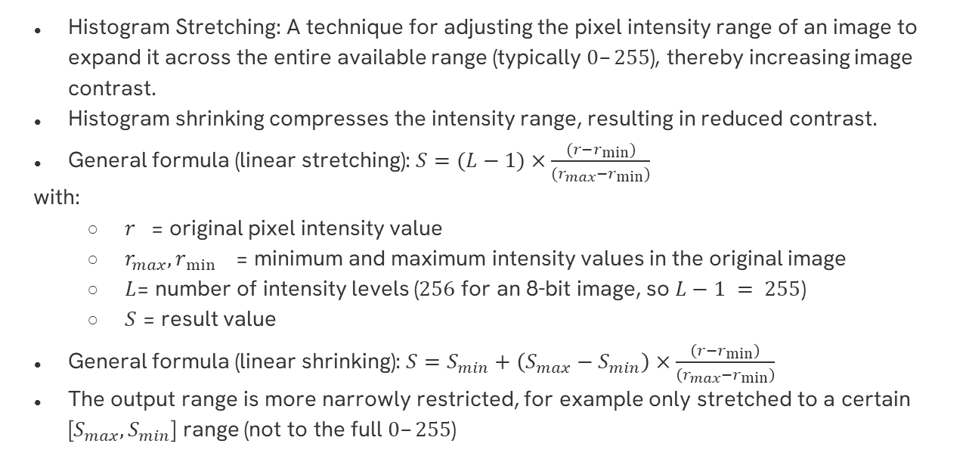
Histogram Stretching/Shrinking
Histogram Stretching: A technique for adjusting the pixel intensity range of an image to expand it across the entire available range (typically $0–255$), thereby increasing image contrast.
Histogram shrinking compresses the intensity range, resulting in reduced contrast.
General formula (linear stretching): $S=(L−1)×\frac{(r−r_{min})}{(r_{max}−r_{min})}$
with:
  $r_{}$= original pixel intensity value
  $r_{max},r_{\min{}}$= minimum and maximum intensity values ​​in the original image
  $L$= number of intensity levels ($256$ for an 8-bit image, so $L−1 = 255$)
  $S$ = result value
General formula (linear shrinking): $S=S_{min}+\left(S_{max}−S_{min}\right)×\frac{\left(r−r_{min}\right)}{\left(r_{max}−r_{min}\right)}$
The output range is more narrowly restricted, for example only stretched to a certain [$S_{max},S_{min}$] range (not to the full $0–255$)

Slide 5
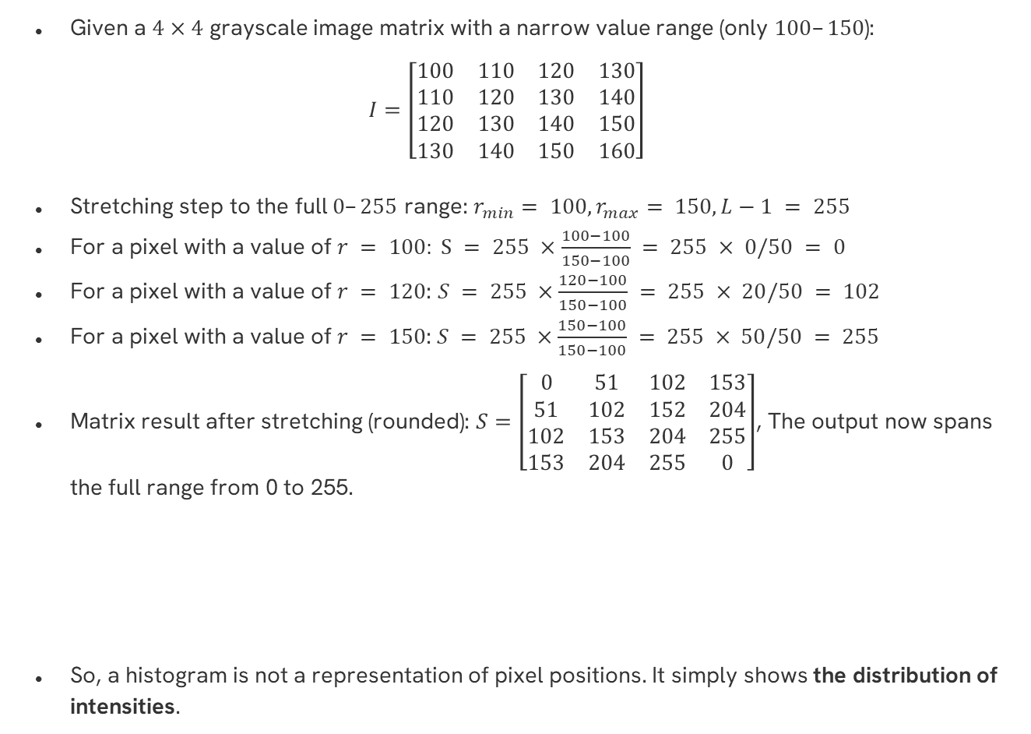
Example to Matrix : Stretching
Given a $4×4$ grayscale image matrix with a narrow value range (only $100–150$):
$$I=\left[\begin{matrix}100 & 110 & 120 & 130 \\ 110 & 120 & 130 & 140 \\ 120 & 130 & 140 & 150 \\ 130 & 140 & 150 & 160\end{matrix}\right]$$
Stretching step to the full $0–255$ range: $r_{min}⁡= 100,r_{max}⁡= 150, L−1 = 255$
For a pixel with a value of $r = 100: S = 255 ×\frac{100−100}{150−100} = 255 × 0/50 = 0$
For a pixel with a value of $r = 120$: $S = 255 ×\frac{120−100}{150−100} = 255 × 20/50 = 102$
For a pixel with a value of $r = 150$:$S = 255 ×\frac{150−100}{150−100} = 255 × 50/50 = 255$
Matrix result after stretching (rounded): $S=\left[\begin{matrix}0 & 51 & 102 & 153 \\ 51 & 102 & 152 & 204 \\ 102 & 153 & 204 & 255 \\ 153 & 204 & 255 & 0\end{matrix}\right]$, The output now spans the full range from 0 to 255.
So, a histogram is not a representation of pixel positions. It simply shows the distribution of intensities.

Slide 6
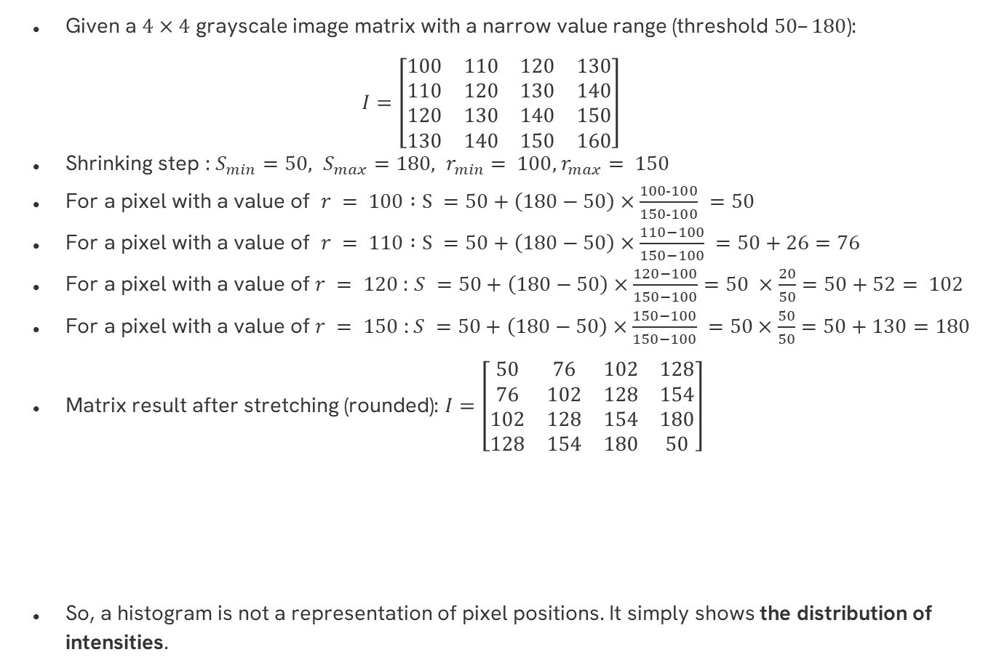
Example to Matrix : Shrinking
Given a $4×4$ grayscale image matrix with a narrow value range (threshold $50–180$):
$$I=\left[\begin{matrix}100 & 110 & 120 & 130 \\ 110 & 120 & 130 & 140 \\ 120 & 130 & 140 & 150 \\ 130 & 140 & 150 & 160\end{matrix}\right]$$
Shrinking step : ${S_{min}=50, S_{max}=180, r}_{min}⁡= 100,{ r}_{max}⁡= 150$
For a pixel with a value of $r = 100 :S =50+\left(180−50\right)×\frac{100−100}{150−100} =50$
For a pixel with a value of $r = 110 :S =50+\left(180−50\right)×\frac{110−100}{150−100} =50+26=76$
For a pixel with a value of $r = 120$: $S =50+\left(180−50\right)×\frac{120−100}{150−100}=50 ×\frac{20}{50}=50+52= 102$
For a pixel with a value of $r = 150$ :$S =50+\left(180−50\right)×\frac{150−100}{150−100} =50×\frac{50}{50}=50+130=180$
Matrix result after stretching (rounded): $I=\left[\begin{matrix}50 & 76 & 102 & 128 \\ 76 & 102 & 128 & 154 \\ 102 & 128 & 154 & 180 \\ 128 & 154 & 180 & 50\end{matrix}\right]$
So, a histogram is not a representation of pixel positions. It simply shows the distribution of intensities.

Slide 7
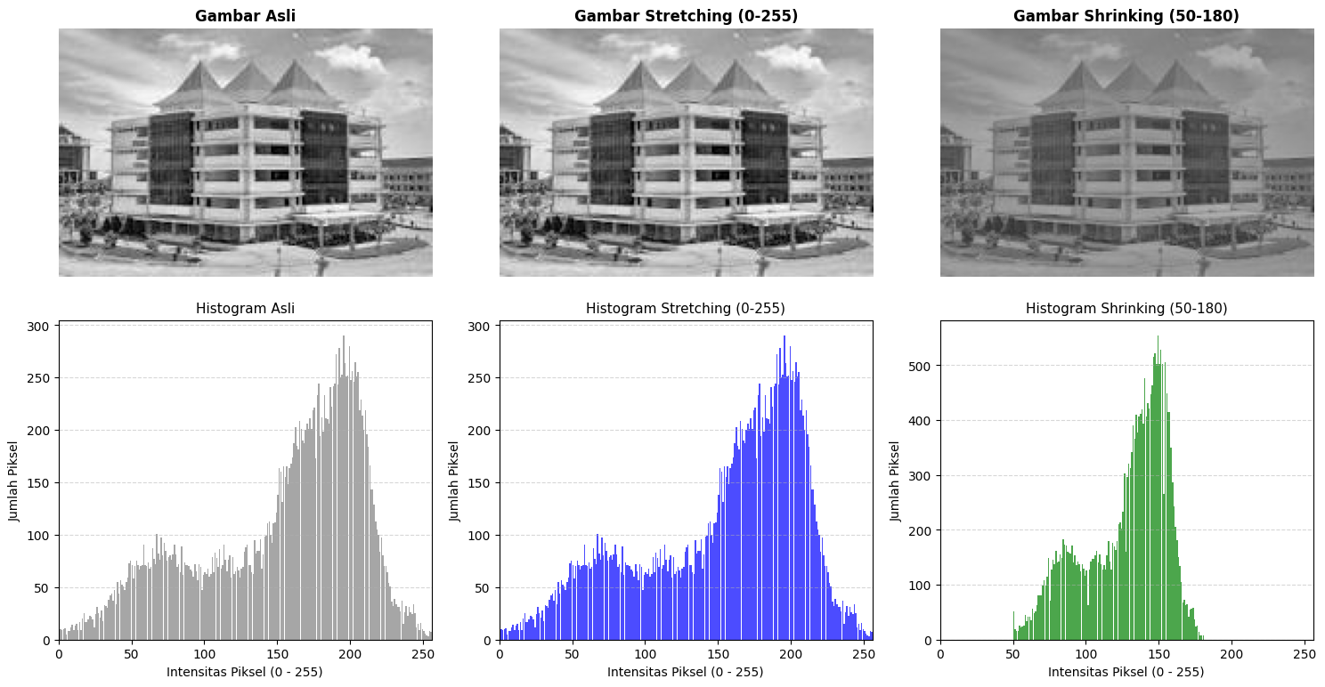
Interpretation in Image
result = s_min + (s_max - s_min) * (citra_float - r_min) / (r_max - r_min)
return np.clip(hasil, 0, 255).astype(np.uint8)
# Stretching 0-255
citra_stretch = histogram_stretching(citra_gray, s_min=0, s_max=255)
# Shrinking 50-180 (contrast reduced)
citra_shrink = histogram_stretching(citra_gray, s_min=50, s_max=180)

Slide 8
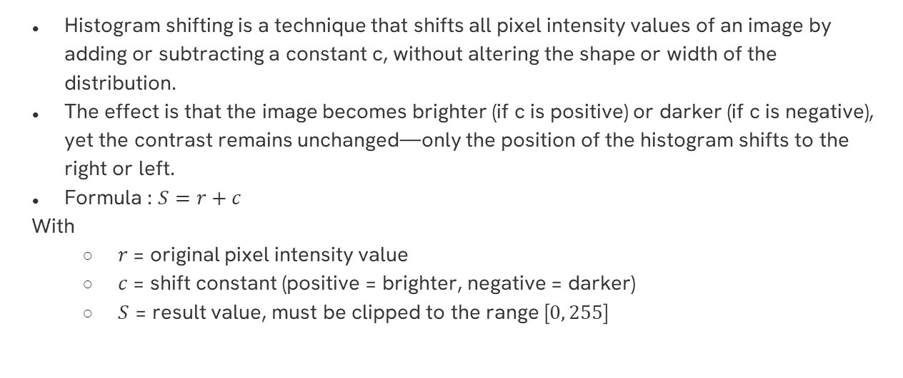
Histogram Shifting
Histogram shifting is a technique that shifts all pixel intensity values ​​of an image by adding or subtracting a constant c, without altering the shape or width of the distribution.
The effect is that the image becomes brighter (if c is positive) or darker (if c is negative), yet the contrast remains unchanged—only the position of the histogram shifts to the right or left.
Formula : $S=r+c$
With
  $r$= original pixel intensity value
  $c$= shift constant (positive = brighter, negative = darker)
  $S$ = result value, must be clipped to the range [$0, 255$]

Slide 9
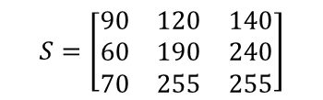
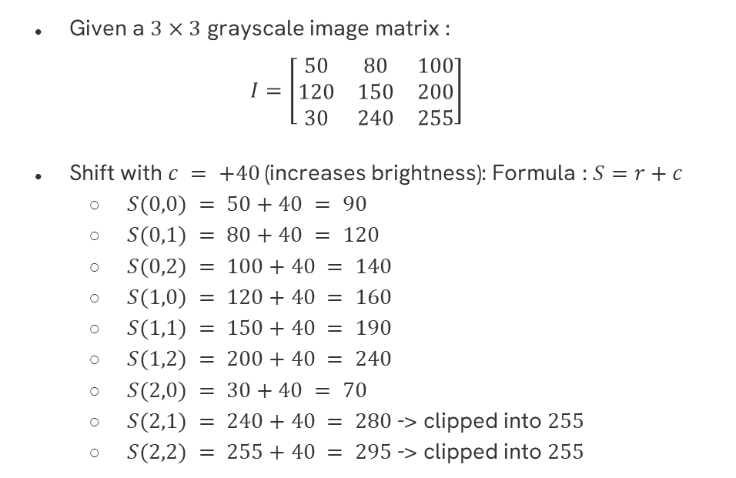
Example to Matrix
Given a $3×3$ grayscale image matrix :
$$I=\left[\begin{matrix}50 & 80 & 100 \\ 120 & 150 & 200 \\ 30 & 240 & 255\end{matrix}\right]$$
Shift with $c = +40$(increases brightness): Formula : $S=r+c$
  $S(0,0) = 50+40 = 90$
  $S(0,1) = 80+40 = 120$
  $S(0,2) = 100+40 = 140$
  $S(1,0) = 120+40 = 160$
  $S(1,1) = 150+40 = 190$
  $S(1,2) = 200+40 = 240$
  $S(2,0) = 30+40 = 70$
  $S(2,1) = 240+40 = 280$-> clipped into $255$
  $S(2,2) = 255+40 = 295$-> clipped into $255$
$$S=\left[\begin{matrix}90 & 120 & 140 \\ 60 & 190 & 240 \\ 70 & 255 & 255\end{matrix}\right]$$

Slide 10
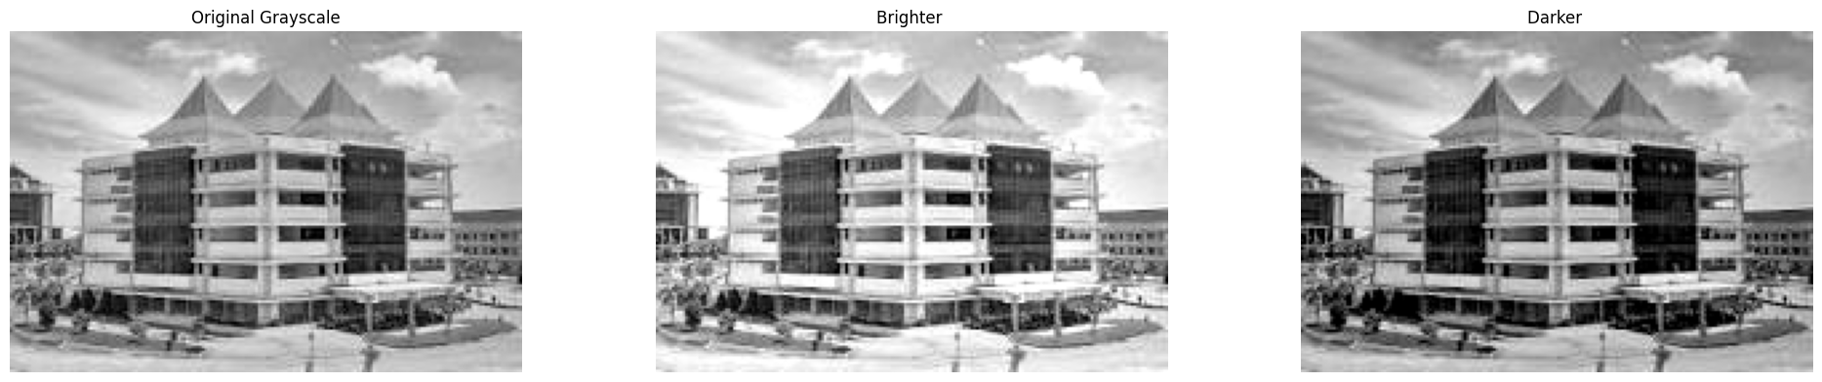
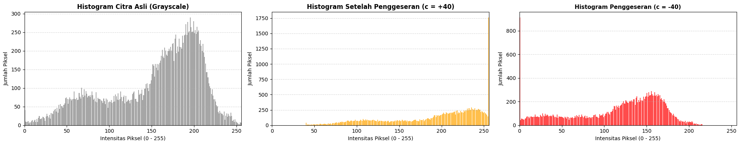
Interpretation in Image
result = citra.astype(int) + c
return np.clip(result, 0, 255).astype(np.uint8)
citra_bright = geser_histogram(citra_gray, c=40) # swipe right (brighter)
citra_dark = geser_histogram(citra_gray, c=-40) # swipe left(darker)

Slide 11
FILTERING
Statistical filtering (order-statistic filtering) is a filtering technique that sorts pixel values ​​within a neighborhood window and then selects one of the order statistics as the output value such as the median, minimum, maximum, or mode.
Filter | How It Works | Main Uses
Median Filter | Taking the median value from the sorted window | Removing salt-and-pepper noise without excessively blurring edges
Min Filter | Takes the smallest value in the window | Removes bright noise (salt noise), darkens the image
Max Filter | Taking the maximum value within the window | Removing dark noise (pepper noise), brightening the image
Mode Filter | Taking the most frequently occurring value within the window | Smoothing images with large homogeneous areas

Slide 12
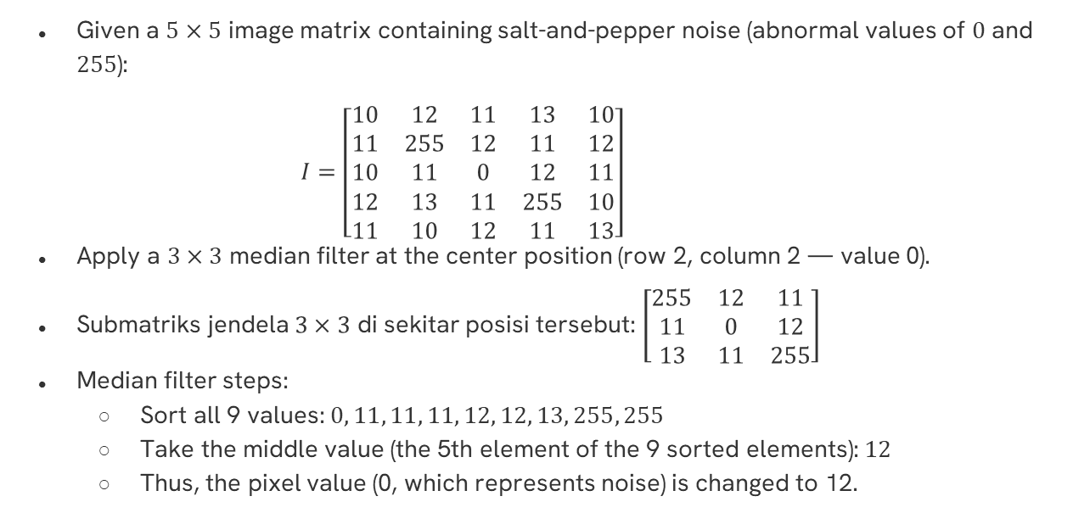
Example to Matrix : Median Filter
Given a $5×5$ image matrix containing salt-and-pepper noise (abnormal values ​​of $0$ and $255$):
    $$I=\left[\begin{matrix}10 & 12 & 11 & 13 & 10 \\ 11 & 255 & 12 & 11 & 12 \\ 10 & 11 & 0 & 12 & 11 \\ 12 & 13 & 11 & 255 & 10 \\ 11 & 10 & 12 & 11 & 13\end{matrix}\right]$$
Apply a $3×3$ median filter at the center position (row 2, column 2 — value 0).
Submatriks jendela $3×3$ di sekitar posisi tersebut: $\left[\begin{matrix}255 & 12 & 11 \\ 11 & 0 & 12 \\ 13 & 11 & 255\end{matrix}\right]$
Median filter steps:
  Sort all 9 values: $0, 11, 11, 11, 12, 12, 13, 255, 255$
  Take the middle value (the 5th element of the 9 sorted elements): $12$
  Thus, the pixel value (0, which represents noise) is changed to 12.

Slide 13
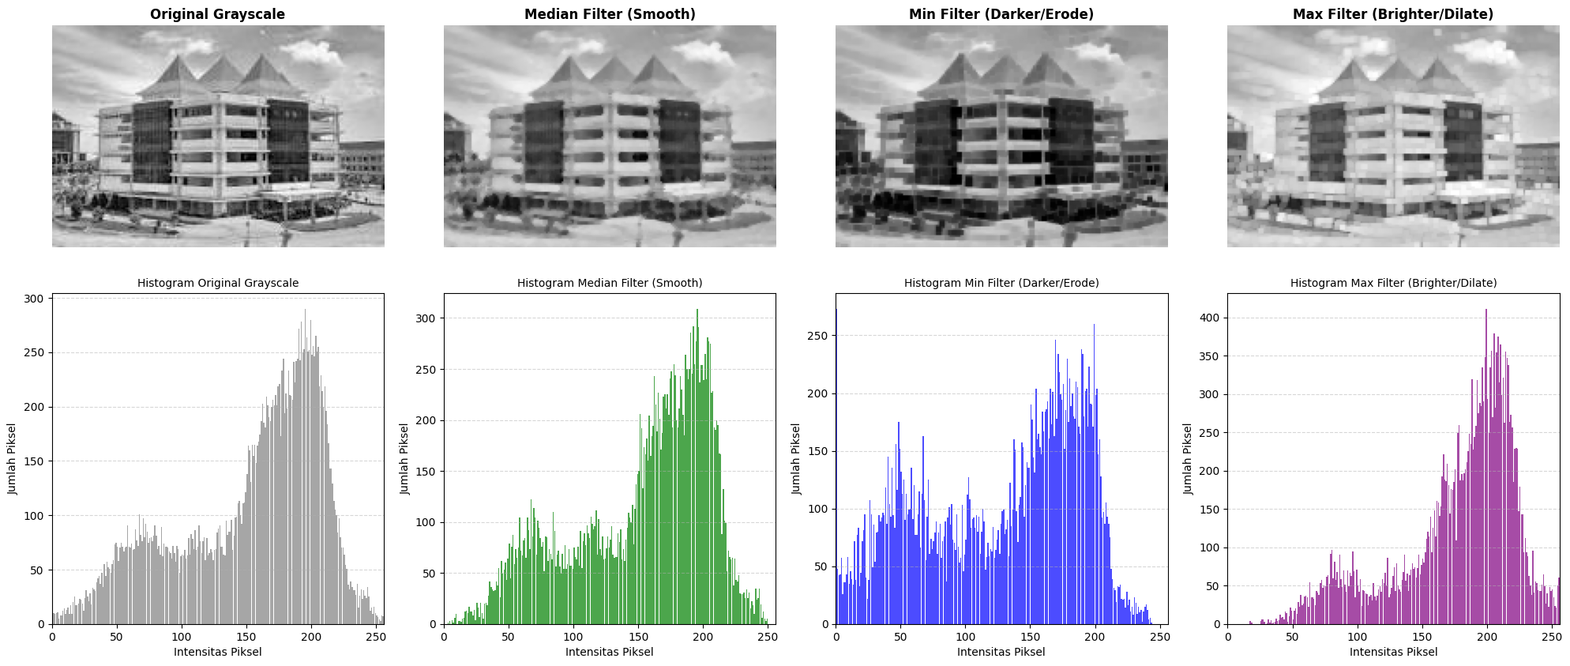
Interpretation in Image
hasil_median = cv2.medianBlur(citra_gray, ksize=3)
hasil_min = minimum_filter(citra_gray, size=3)
hasil_max = maximum_filter(citra_gray, size=3)

Slide 14
Filtering Using an Algebraic Approach
Algebraic filtering (linear/algebraic filter is a filtering technique that employs multiplication and addition operations between pixel values ​​and kernel weights—this is the form of 2D convolution.
A mathematical operation that modifies or enhances an image by changing its pixel values using a small matrix called a kernel.
Filter | How It Works | Main Uses
Mean Filter (Low-pass) | Uniform average (1/9 for each 3×3 element) | Smooth/blur, reduce noise
Weighted Average Filter | Non-uniform weight, larger center | Smooths while preserving detail
High-pass Filter | Kernel with a large positive center and negative neighbors | Sharpening, edge enhancement

Slide 15
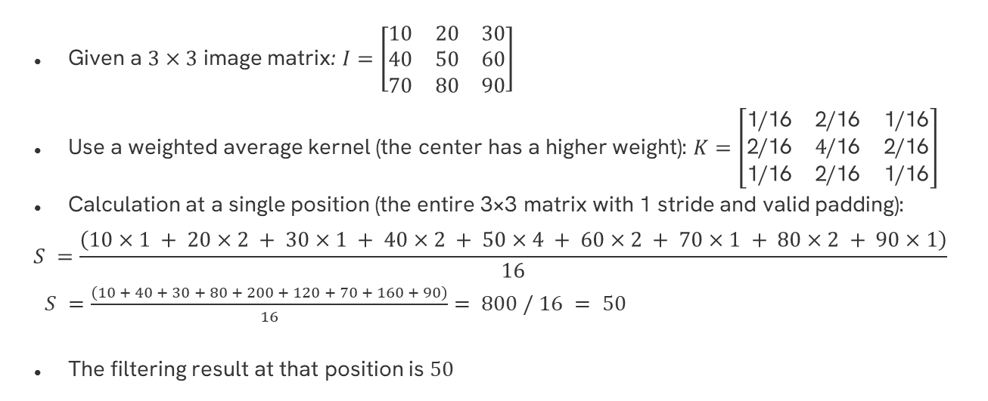
Example to Matrix : Weighted Average Filter
Given a $3×3$ image matrix: $I=\left[\begin{matrix}10 & 20 & 30 \\ 40 & 50 & 60 \\ 70 & 80 & 90\end{matrix}\right]$
Use a weighted average kernel (the center has a higher weight): $K=\left[\begin{matrix}\text{1/16} & \text{2/16} & \text{1/16} \\ \text{2/16} & \text{4}\text{/16} & \text{2/16} \\ \text{1/16} & \text{2/16} & \text{1/16}\end{matrix}\right]$
Calculation at a single position (the entire 3×3 matrix with 1 stride and valid padding):
$$S =\frac{\left(10×1 + 20×2 + 30×1 + 40×2 + 50×4 + 60×2 + 70×1 + 80×2 + 90×1\right)}{16}$$
$S =\frac{\left(10 + 40 + 30 + 80 + 200 + 120 + 70 + 160 + 90\right)}{16}= 800 / 16 = 50$
The filtering result at that position is $50$

Slide 16
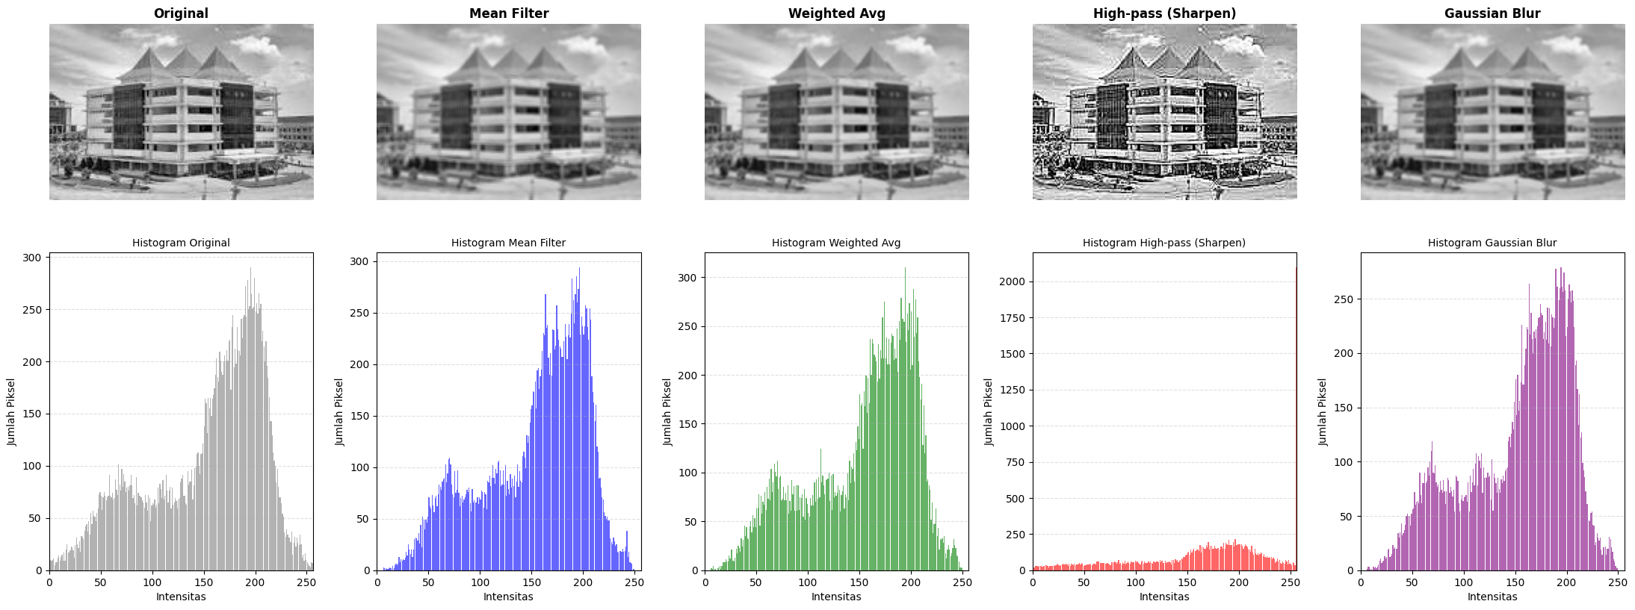
Interpretation in Image

Slide 17
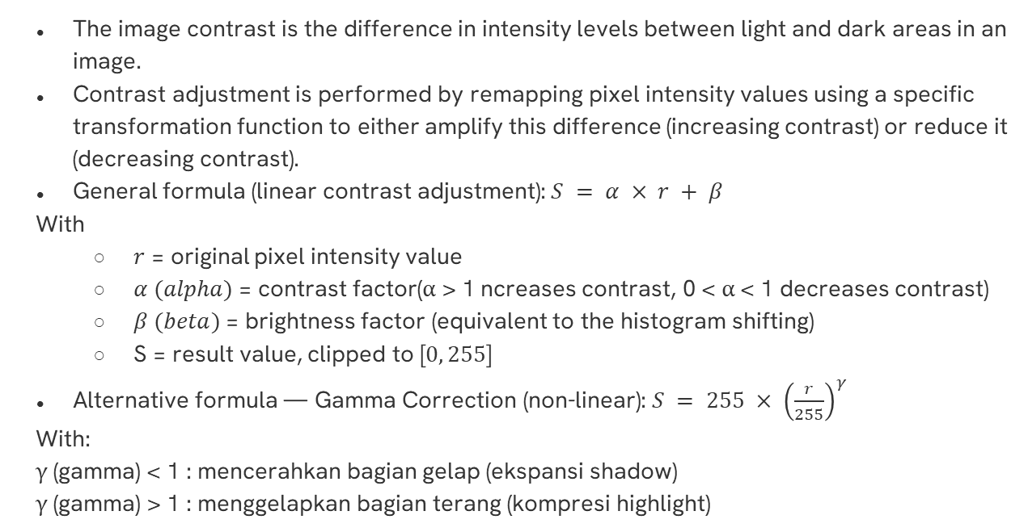
Image Contrast Adjustment
The image contrast is the difference in intensity levels between light and dark areas in an image.
Contrast adjustment is performed by remapping pixel intensity values ​​using a specific transformation function to either amplify this difference (increasing contrast) or reduce it (decreasing contrast).
General formula (linear contrast adjustment):$S = α × r + β$
With
  $r$ = original pixel intensity value
  $α (alpha)$= contrast factor(α > 1 ncreases contrast, 0 < α < 1 decreases contrast)
  $β (beta)$= brightness factor (equivalent to the histogram shifting)
  S = result value, clipped to [$0, 255$]
Alternative formula — Gamma Correction (non-linear): $S = 255 × {\left(\frac{r}{255}\right)}^{γ}$
With:
γ (gamma) < 1 : mencerahkan bagian gelap (ekspansi shadow)
γ (gamma) > 1 : menggelapkan bagian terang (kompresi highlight)

Slide 18
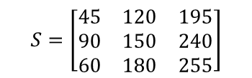
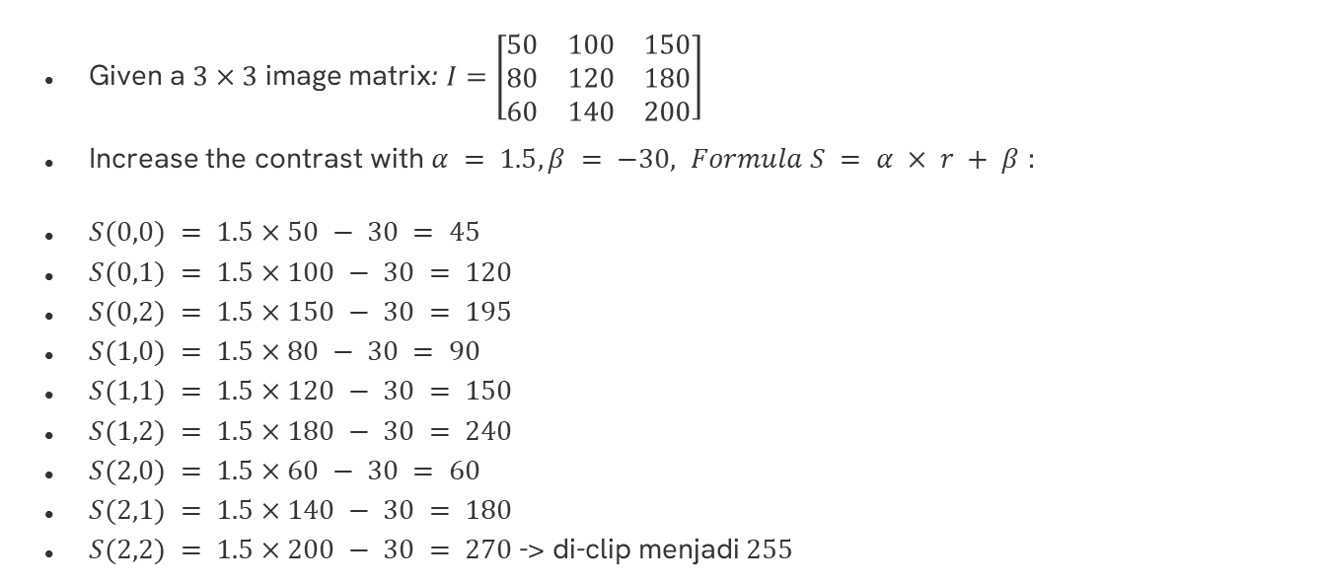
Example to Matrix
Given a $3×3$ image matrix: $I=\left[\begin{matrix}50 & 100 & 150 \\ 80 & 120 & 180 \\ 60 & 140 & 200\end{matrix}\right]$
Increase the contrast with $α = 1.5, β = −30, Formula S = α × r + β$ :
$S(0,0) = 1.5×50 − 30 = 45$
$S(0,1) = 1.5×100 − 30 = 120$
$S(0,2) = 1.5×150 − 30 = 195$
$S(1,0) = 1.5×80 − 30 = 90$
$S(1,1) = 1.5×120 − 30 = 150$
$S(1,2) = 1.5×180 − 30 = 240$
$S(2,0) = 1.5×60 − 30 = 60$
$S(2,1) = 1.5×140 − 30 = 180$
$S(2,2) = 1.5×200 − 30 = 270$-> di-clip menjadi $255$
$$S=\left[\begin{matrix}45 & 120 & 195 \\ 90 & 150 & 240 \\ 60 & 180 & 255\end{matrix}\right]$$

Slide 19
Interpretation in Image
hasil = alpha * citra.astype(float) + beta
return np.clip(hasil, 0, 255).astype(np.uint8)
citra_kontras_naik = ubah_kontras(citra_gray, alpha=1.5, beta=-30)
citra_kontras_turun = ubah_kontras(citra_gray, alpha=0.6, beta=40)
# Cara langsung dengan OpenCV (otomatis clipping)
citra_kontras_cv = cv2.convertScaleAbs(citra_gray, alpha=1.5, beta=-30)
# --- Gamma Correction ---
def koreksi_gamma(citra, gamma=1.0):
citra_norm = citra.astype(float) / 255.0
hasil = np.power(citra_norm, gamma) * 255.0
return np.clip(hasil, 0, 255).astype(np.uint8)
citra_gamma_terang = koreksi_gamma(citra_gray, gamma=0.5) #
citra_gamma_gelap = koreksi_gamma(citra_gray, gamma=2.0) #
)

Slide 20
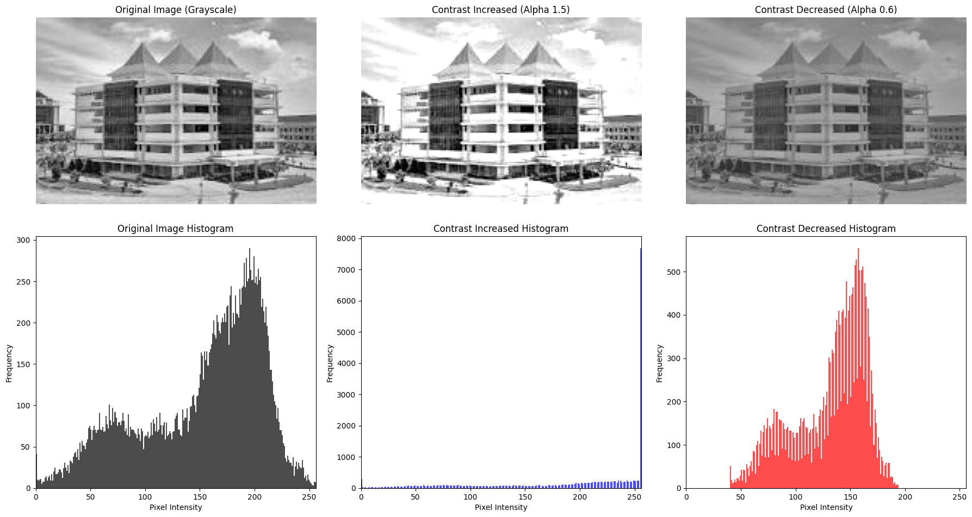
Interpretation in Image

Slide 21
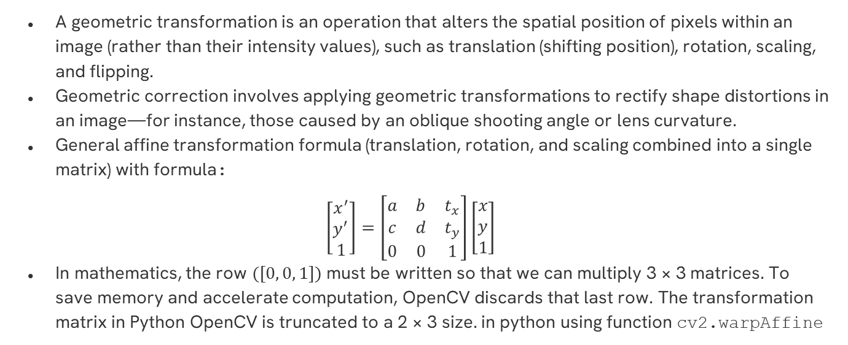
Geometric Transformation and Correction
A geometric transformation is an operation that alters the spatial position of pixels within an image (rather than their intensity values), such as translation (shifting position), rotation, scaling, and flipping.
Geometric correction involves applying geometric transformations to rectify shape distortions in an image—for instance, those caused by an oblique shooting angle or lens curvature.
General affine transformation formula (translation, rotation, and scaling combined into a single matrix) with formula:
$$\left[\begin{matrix}x^{′} \\ y^{′} \\ 1\end{matrix}\right]=\left[\begin{matrix}a & b & t_{x} \\ c & d & t_{y} \\ 0 & 0 & 1\end{matrix}\right]\left[\begin{matrix}x \\ y \\ 1\end{matrix}\right]$$
In mathematics, the row $([0, 0, 1])$must be written so that we can multiply 3 × 3 matrices. To save memory and accelerate computation, OpenCV discards that last row. The transformation matrix in Python OpenCV is truncated to a 2 × 3 size. in python using function cv2.warpAffine

Slide 22
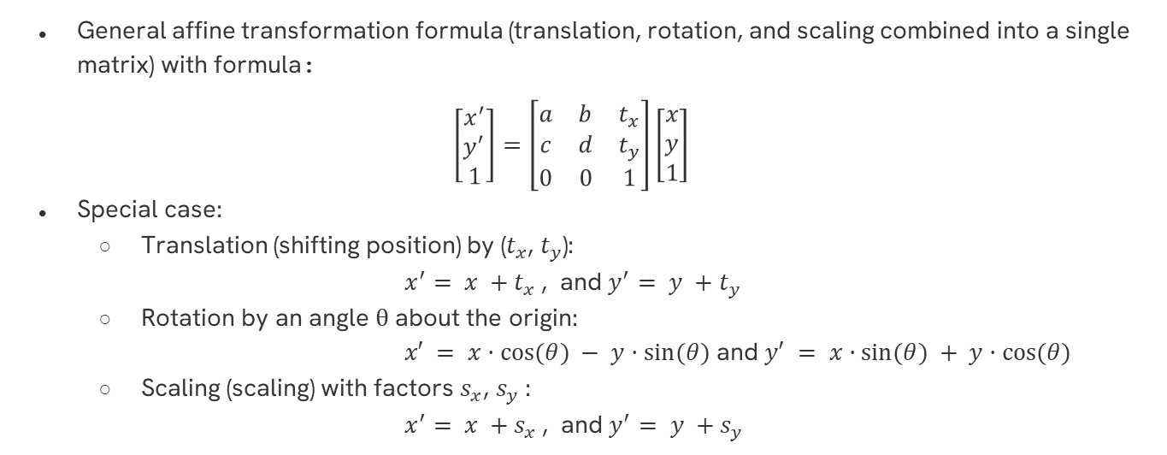
Geometric Transformation and Correction
General affine transformation formula (translation, rotation, and scaling combined into a single matrix) with formula:
$$\left[\begin{matrix}x^{′} \\ y^{′} \\ 1\end{matrix}\right]=\left[\begin{matrix}a & b & t_{x} \\ c & d & t_{y} \\ 0 & 0 & 1\end{matrix}\right]\left[\begin{matrix}x \\ y \\ 1\end{matrix}\right]$$
Special case:
  Translation (shifting position) by ($t_{x}$, $t_{y}$):
        $x^{′}= x +t_{x}$, and $y^{′}= y +t_{y}$
  Rotation by an angle θ about the origin:
  $x′ = x·cos⁡(θ) − y·sin⁡(θ)$and $y′ = x·sin⁡(θ) + y·cos⁡(θ)$
  Scaling (scaling) with factors $s_{x}$, $s_{y}$:
  $x^{′}= x +s_{x}$, and $y^{′}= y +s_{y}$

Slide 23
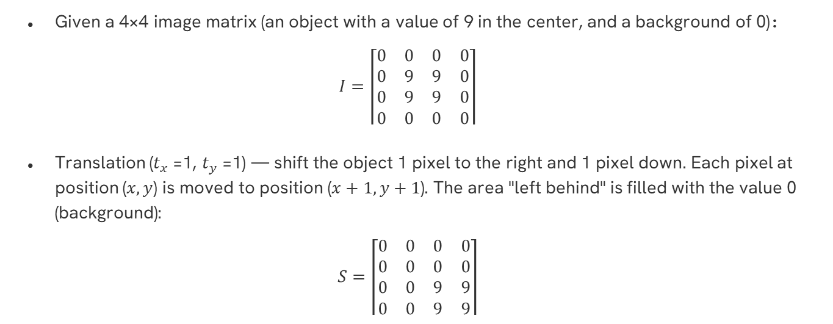
Example to matrix
Given a 4×4 image matrix (an object with a value of 9 in the center, and a background of 0):
$$I=\left\lceil \begin{matrix}0 & 0 & 0 & 0 \\ 0 & 9 & 9 & 0 \\ 0 & 9 & 9 & 0 \\ 0 & 0 & 0 & 0\end{matrix}\right\rceil$$
Translation ($t_{x}$=1, $t_{y}$=1) — shift the object 1 pixel to the right and 1 pixel down. Each pixel at position ($x,y$) is moved to position ($x+1, y+1$). The area "left behind" is filled with the value 0 (background):
$$S=\left\lceil \begin{matrix}0 & 0 & 0 & 0 \\ 0 & 0 & 0 & 0 \\ 0 & 0 & 9 & 9 \\ 0 & 0 & 9 & 9\end{matrix}\right\rceil$$

Slide 24
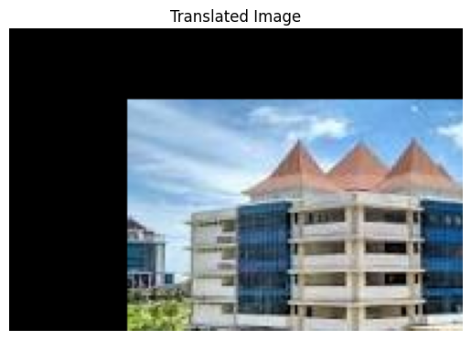
Interpretation in Image
Shift an image (translate it) by 50 pixels to the right $((t_{x}=50))$and $30$ pixels down $((t_{y}=30))$
tinggi_gambar, lebar_gambar = img.shape[:2]
# MENCIPTAKAN MATRIKS 2x3 (Bukan 3x3)
# Karena ini translasi: a=1, b=0, c=0, d=1
tx, ty = 50, 30
matriks_translasi = np.float32([
[1, 0, tx],
[0, 1, ty]
])
# Menerapkan transformasi afinitas
# OpenCV secara otomatis kalkulasi koordinat
img_hasil = cv2.warpAffine(img, M, (lebar_gambar, tinggi_gambar))

Slide 25
Interpretation in Image
Shift an image (translate it) by 50 pixels to the right $((t_{x}=50))$and $30$ pixels down $((t_{y}=30))$
--- 1. Translasi (pergeseran posisi) ---
tx, ty = 50, 30
matriks_translasi = np.float32([
[1, 0, tx],
[0, 1, ty]
])
citra_translasi = cv2.warpAffine(citra_gray, matriks_translasi, (lebar, tinggi))
# --- 2. Rotasi ---
pusat = (lebar // 2, tinggi // 2)
sudut = 30 # derajat, positif = berlawanan arah jarum jam
skala_rotasi = 1.0
matriks_rotasi = cv2.getRotationMatrix2D(pusat, sudut, skala_rotasi)
citra_rotasi = cv2.warpAffine(citra_gray, matriks_rotasi, (lebar, tinggi))
# --- 3. Penskalaan (scaling / resize) ---
citra_perbesar = cv2.resize(citra_gray, None, fx=1.5, fy=1.5, interpolation=cv2.INTER_LINEAR)
citra_perkecil = cv2.resize(citra_gray, None, fx=0.5, fy=0.5, interpolation=cv2.INTER_AREA)
# --- 4. Geometrik dengan Transformasi Perspektif ---
# Contoh: memperbaiki citra dokumen yang terpotret miring (4 titik sudut asli -> 4 titik target persegi)
titik_asal = np.float32([[50, 50], [400, 30], [30, 500], [420, 480]])
titik_tujuan = np.float32([[0, 0], [400, 0], [0, 500], [400, 500]])
matriks_perspektif = cv2.getPerspectiveTransform(titik_asal, titik_tujuan)
citra_terkoreksi = cv2.warpPerspective(citra_gray, matriks_perspektif, (400, 500))

Slide 26
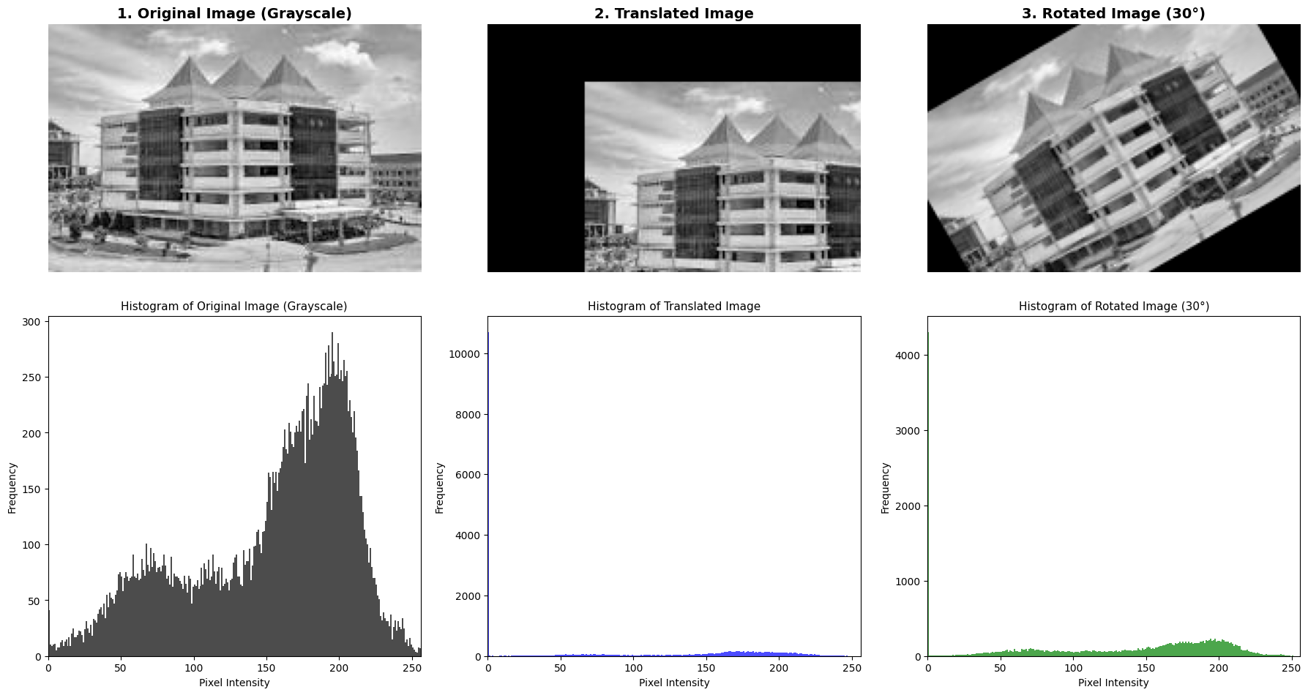
Interpretation in Image

Slide 27
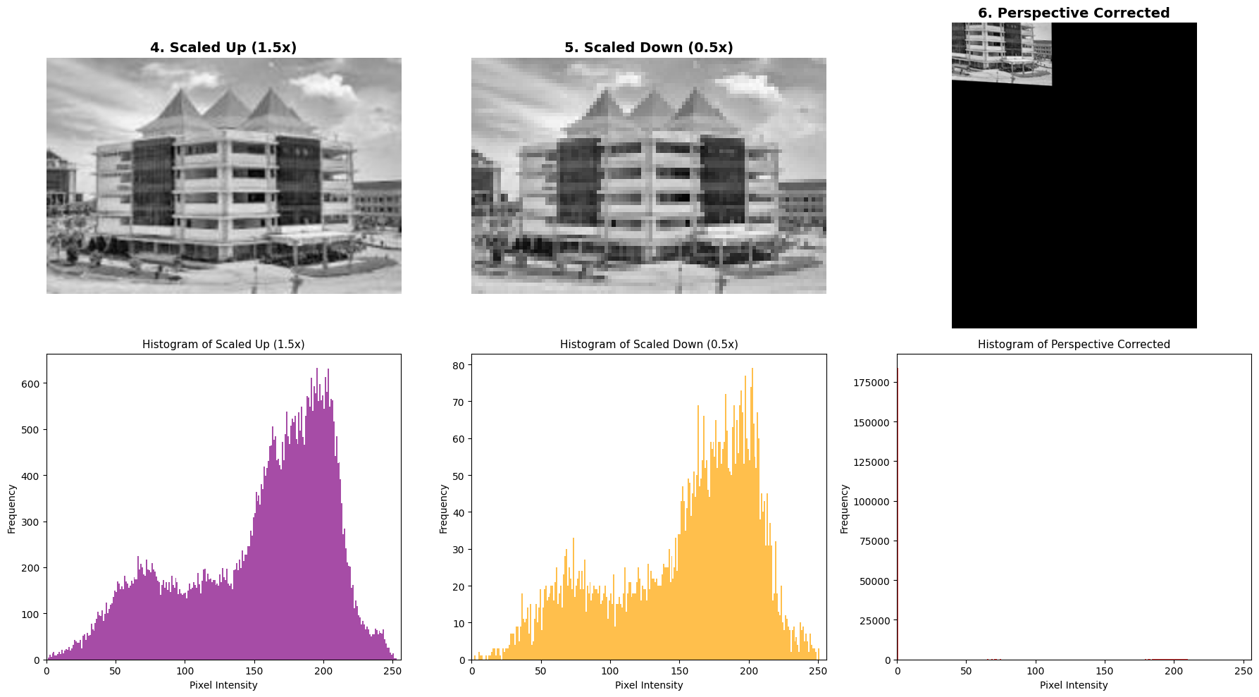
Interpretation in Image

Slide 28
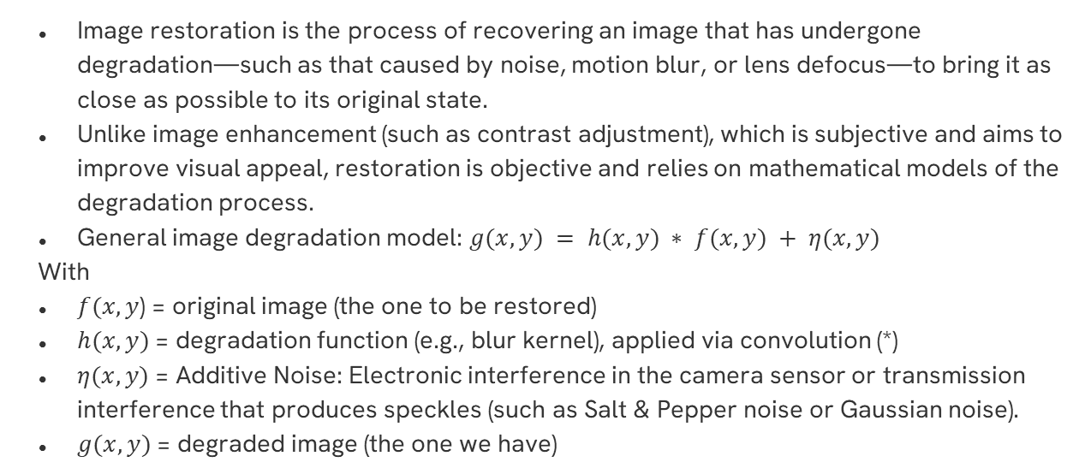
IMAGE RESTORATION
Image restoration is the process of recovering an image that has undergone degradation—such as that caused by noise, motion blur, or lens defocus—to bring it as close as possible to its original state.
Unlike image enhancement (such as contrast adjustment), which is subjective and aims to improve visual appeal, restoration is objective and relies on mathematical models of the degradation process.
General image degradation model: $g(x,y) = h(x,y) ∗ f(x,y) + η(x,y)$
With
$f(x,y$) = original image (the one to be restored)
$h(x,y)$= degradation function (e.g., blur kernel), applied via convolution (*)
$η(x,y)$= Additive Noise: Electronic interference in the camera sensor or transmission interference that produces speckles (such as Salt & Pepper noise or Gaussian noise).
$g(x,y)$= degraded image (the one we have)

Slide 29
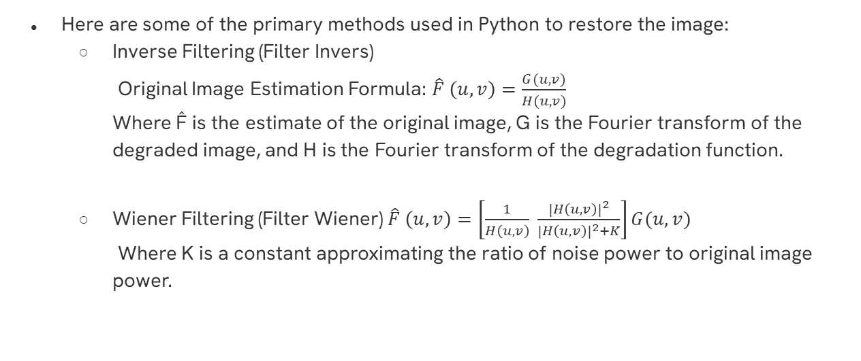
IMAGE RESTORATION
Here are some of the primary methods used in Python to restore the image:
  Inverse Filtering (Filter Invers)
  Original Image Estimation Formula: $\hat{F} \left(u,v\right)=\frac{G(u,v)}{H(u,v)}$
  Where F̂ is the estimate of the original image, G is the Fourier transform of the degraded image, and H is the Fourier transform of the degradation function.
  Wiener Filtering (Filter Wiener) $\hat{F} \left(u,v\right)=\left[\frac{1}{H\left(u,v\right)} \frac{{\left|H\left(u,v\right)\right|}^{2}}{{\left|H\left(u,v\right)\right|}^{2}+K}\right]G(u,v)$
  Where K is a constant approximating the ratio of noise power to original image power.

Slide 30
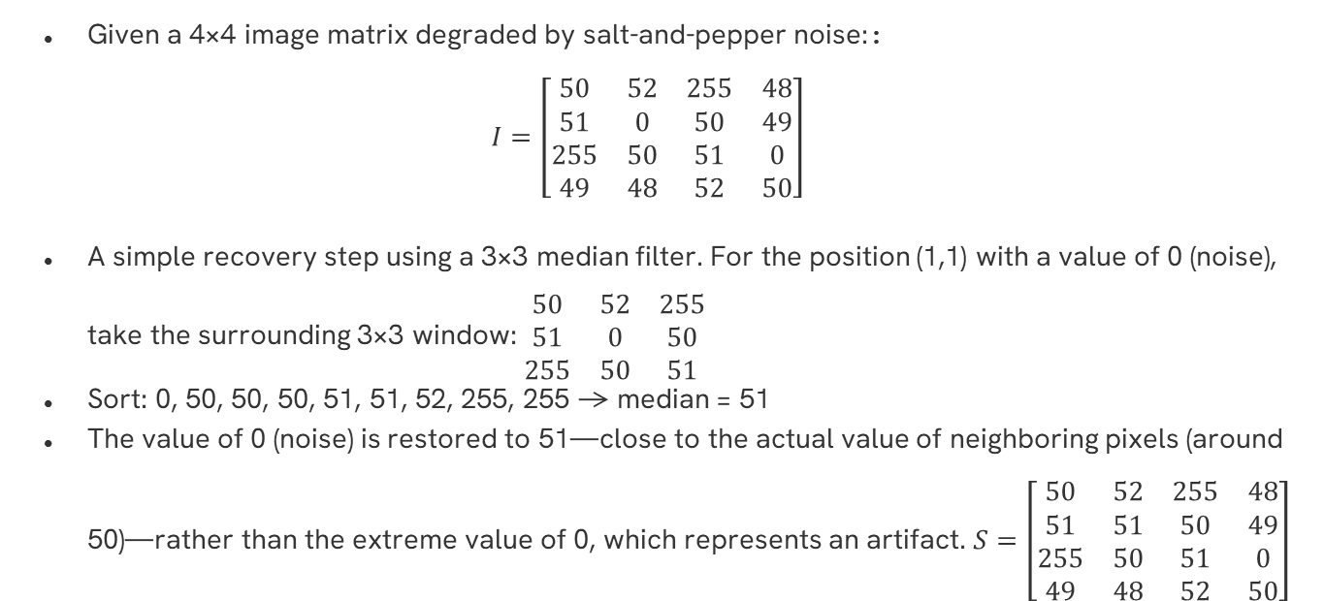
Example to matrix
Given a 4×4 image matrix degraded by salt-and-pepper noise::
$$I=\left[\begin{matrix}50 & 52 & 255 & 48 \\ 51 & 0 & 50 & 49 \\ 255 & 50 & 51 & 0 \\ 49 & 48 & 52 & 50\end{matrix}\right]$$
A simple recovery step using a 3×3 median filter. For the position (1,1) with a value of 0 (noise), take the surrounding 3×3 window: $\begin{matrix}50 & 52 & 255 \\ 51 & 0 & 50 \\ 255 & 50 & 51\end{matrix}$
Sort: 0, 50, 50, 50, 51, 51, 52, 255, 255 → median = 51
The value of 0 (noise) is restored to 51—close to the actual value of neighboring pixels (around 50)—rather than the extreme value of 0, which represents an artifact.$S=\left[\begin{matrix}50 & 52 & 255 & 48 \\ 51 & 51 & 50 & 49 \\ 255 & 50 & 51 & 0 \\ 49 & 48 & 52 & 50\end{matrix}\right]$

Slide 31
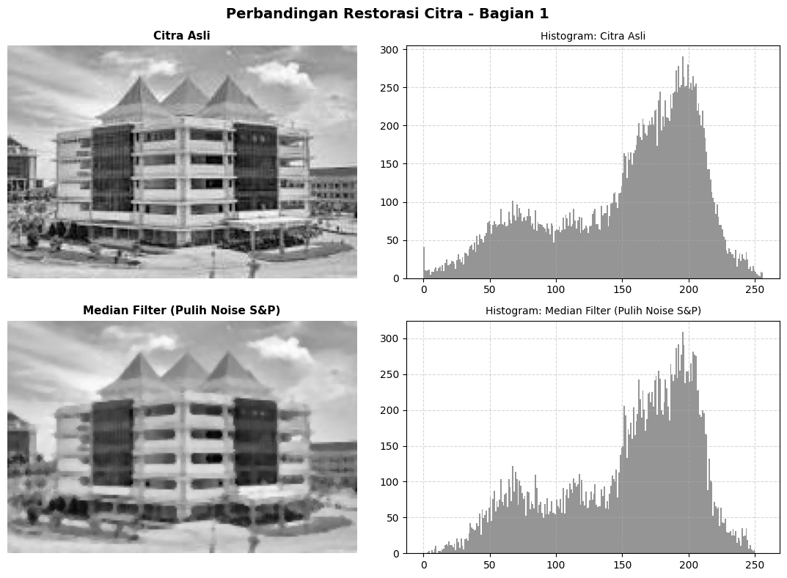
Interpretation in Image
# --- Restorasi dari noise salt-and-pepper (median filter) ---
citra_pulih_noise = cv2.medianBlur(citra_gray, ksize=3)

Slide 32
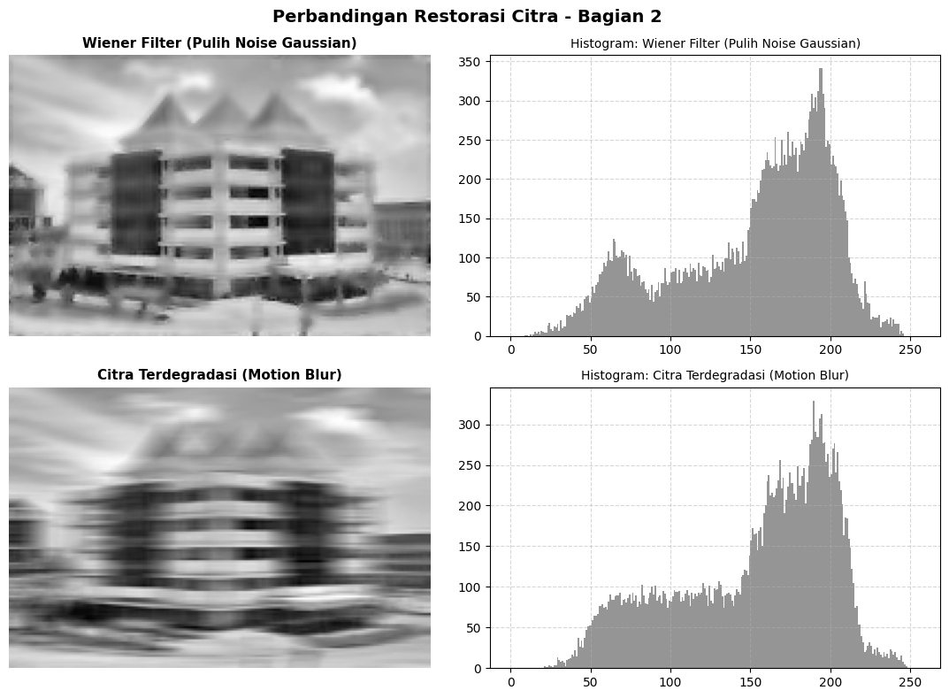
Interpretation in Image
# ---Restorasi dari noise Gaussian (Wiener filter, pendekatan statistik) ---
citra_pulih_wiener = wiener(citra_gray.astype(float), mysize=5)
citra_pulih_wiener = np.clip(citra_pulih_wiener, 0, 255).astype(np.uint8)
# --- Simulasi degradasi motion blur, lalu restorasi dengan inverse filtering ---
def buat_kernel_motion_blur(panjang=15, sudut=0):
kernel = np.zeros((panjang, panjang))
kernel[int((panjang-1)/2), :] = np.ones(panjang)
kernel = kernel / panjang
return kernel
kernel_blur = buat_kernel_motion_blur(panjang=15)
citra_terdegradasi = cv2.filter2D(citra_gray, -1, kernel_blur)

Slide 33
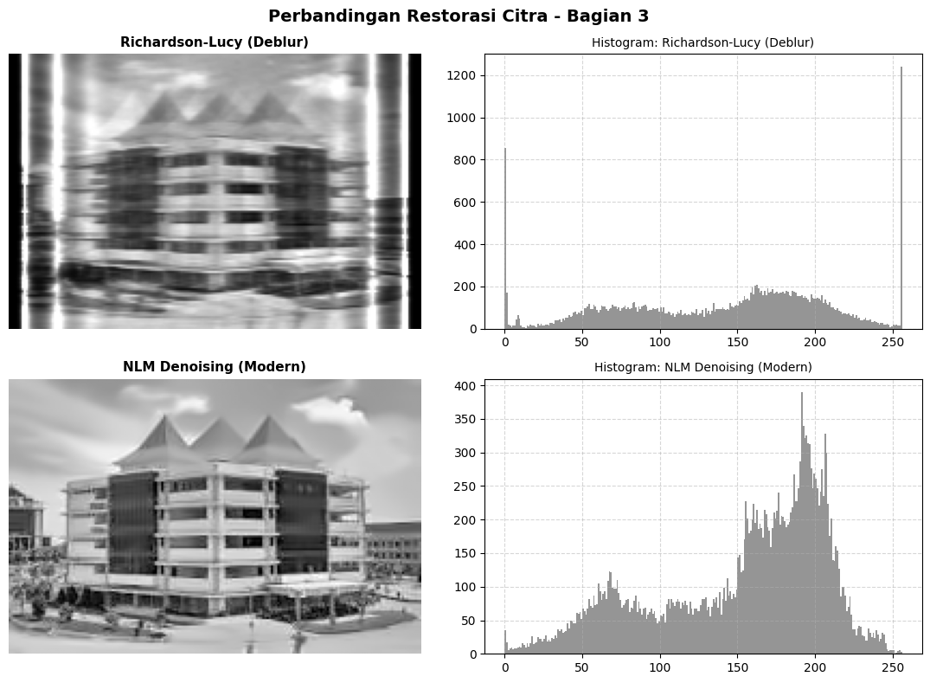
Interpretation in Image
# --- Restorasi dengan algoritma Richardson-Lucy (dekonvolusi iteratif)
citra_float = citra_terdegradasi.astype(float) / 255.0
citra_pulih_deblur = richardson_lucy(citra_float, kernel_blur, num_iter=30)
citra_pulih_deblur = np.clip(citra_pulih_deblur * 255, 0, 255).astype(np.uint8)
# --- Denoising modern non-linear (Non-Local Means, kombinasi statistik & pembobotan) ---
citra_pulih_nlm = cv2.fastNlMeansDenoising(citra_gray, h=10)

Slide 34
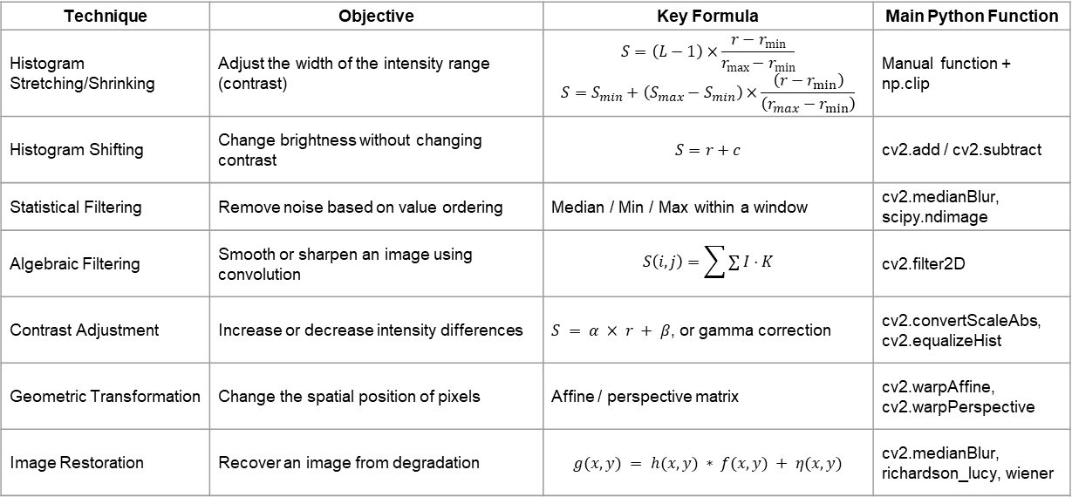
Summary
Technique | Objective | Key Formula | Main Python Function
Histogram Stretching/Shrinking | Adjust the width of the intensity range (contrast) | $$S=\left(L−1\right)×\frac{r−r_{min}}{r_{max}−r_{min}}$$ $$S=S_{min}+\left(S_{max}−S_{min}\right)×\frac{\left(r−r_{min}\right)}{\left(r_{max}−r_{min}\right)}$$ | Manual function + np.clip
Histogram Shifting | Change brightness without changing contrast | $$S=r+c$$ | cv2.add / cv2.subtract
Statistical Filtering | Remove noise based on value ordering | Median / Min / Max within a window | cv2.medianBlur, scipy.ndimage
Algebraic Filtering | Smooth or sharpen an image using convolution | $$S\left(i , j\right)=\sum{∑}I⋅K$$ | cv2.filter2D
Contrast Adjustment | Increase or decrease intensity differences | $S = α × r + β$, or gamma correction | cv2.convertScaleAbs, cv2.equalizeHist
Geometric Transformation | Change the spatial position of pixels | Affine / perspective matrix | cv2.warpAffine, cv2.warpPerspective
Image Restoration | Recover an image from degradation | $$g(x,y) = h(x,y) ∗ f(x,y) + η(x,y)$$ | cv2.medianBlur, richardson_lucy, wiener

Slide 35
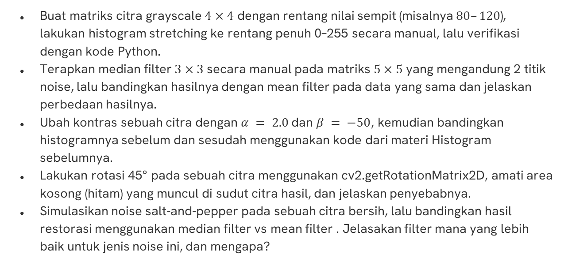
Exercise
Buat matriks citra grayscale $4×4$ dengan rentang nilai sempit (misalnya $80–120$), lakukan histogram stretching ke rentang penuh 0–255 secara manual, lalu verifikasi dengan kode Python.
Terapkan median filter $3×3$secara manual pada matriks $5×5$yang mengandung 2 titik noise, lalu bandingkan hasilnya dengan mean filter pada data yang sama dan jelaskan perbedaan hasilnya.
Ubah kontras sebuah citra dengan $α = 2.0$dan $β = −50$, kemudian bandingkan histogramnya sebelum dan sesudah menggunakan kode dari materi Histogram sebelumnya.
Lakukan rotasi 45° pada sebuah citra menggunakan cv2.getRotationMatrix2D, amati area kosong (hitam) yang muncul di sudut citra hasil, dan jelaskan penyebabnya.
Simulasikan noise salt-and-pepper pada sebuah citra bersih, lalu bandingkan hasil restorasi menggunakan median filter vs mean filter . Jelasakan filter mana yang lebih baik untuk jenis noise ini, dan mengapa?

Slide 36
REFERENSI
Gonzalez, R. C., & Woods, R. E. (2018). Digital Image Processing (4th ed.). Pearson.
Szeliski, R. (2022). Computer Vision: Algorithms and Applications (2nd ed.). Springer.
Putra, D. (2010). Pengolahan Citra Digital. Andi Offset.
Pizer, S. M., et al. (1987). Adaptive histogram equalization and its variations. Computer Vision, Graphics, and Image Processing, 39(3), 355–368.
Wiener, N. (1949). Extrapolation, Interpolation, and Smoothing of Stationary Time Series. MIT Press.
Buades, A., Coll, B., & Morel, J. M. (2005). "A non-local algorithm for image denoising". IEEE Computer Society Conference on Computer Vision and Pattern Recognition (CVPR).

Slide 37
Thanks!
Do you have any questions?
youremail@freepik.com
+34 654 321 432
yourwebsite.com
Please keep this slide for attribution

